Slide 1


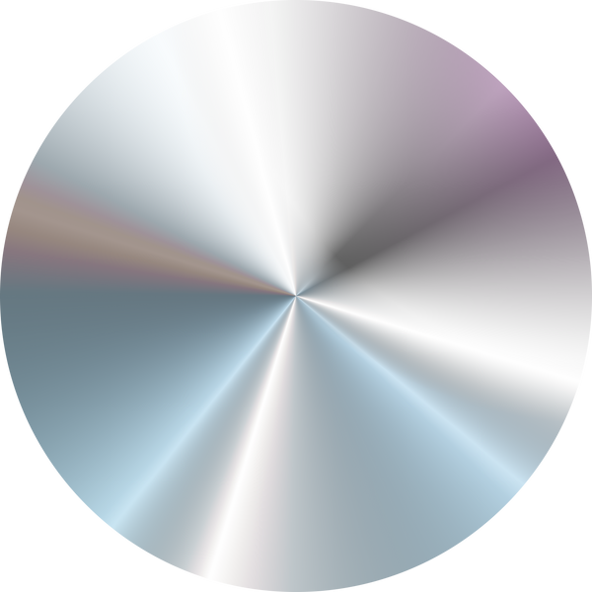
A.F.M Khairul Amin 2012815642
Md. Waliur Rahman - 2011306042
Abdullah Al-Galib Id- 1712986642
Autonomous driving car using AI

Slide 2

PROJECT OVERVIEW
aaaa
The goal is to enable a vehicle to navigate safely and efficiently without human intervention.
This system leverages computer vision and deep learning techniques to perceive the environment, detect objects, and make real-time driving decisions.nt in certain industries.
Our project focuses on developing an autonomous car driving system powered by neural networks.

Slide 3
DATASET: BDD100K - IMAGES 10K
01
02
03
To train and evaluate our model, we use the BDD100K: Images 10K Dataset, which is widely used in the automotive industry for instance segmentation, semantic segmentation, and object detection.
This dataset provides diverse driving scenes with various weather conditions, times of day, and urban/rural environments, making it ideal for building a robust autonomous driving model.
we will use a small version of it as a sample version of it and the limitation of our device's computational power .

Slide 4
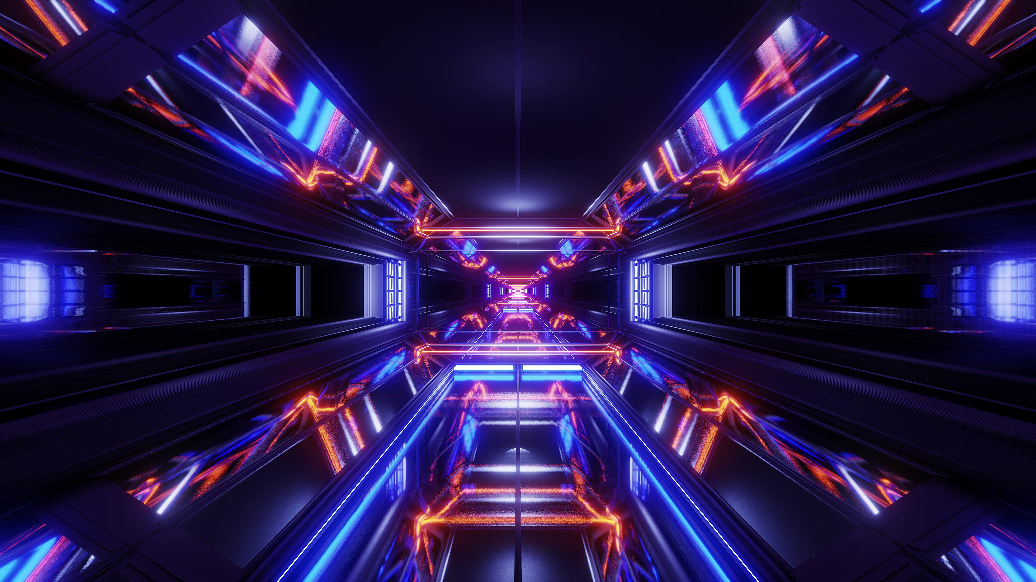
Project Goals
Develop a highly accurate neural network model for real-time perception.
Improve safety and efficiency by reducing false positives and negatives in detection.
Enable seamless integration with autonomous vehicle control systems.

Slide 5
KEY TECHNOLOGY :
Deep Learning Frameworks:
Dataset Processing:
For result
TensorFlow/PyTorch
Dataset Processing: OpenCV, NumPy, Pandas
view result graph we use math plot .
Neural Network Models: CNNs, RNNs

Slide 6
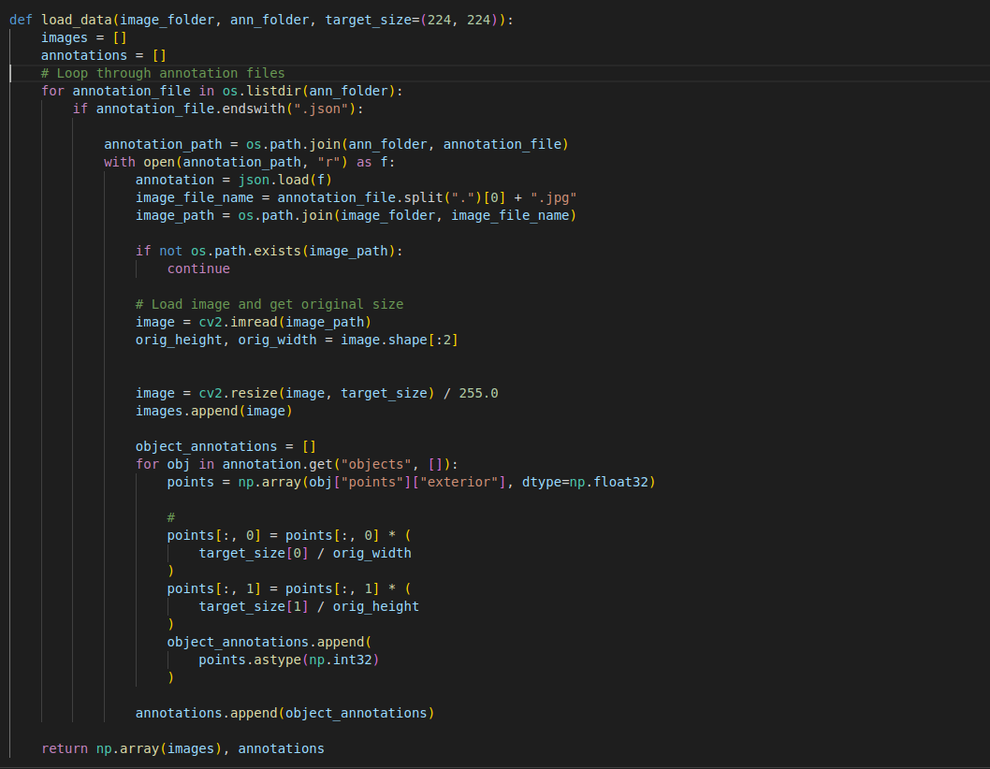
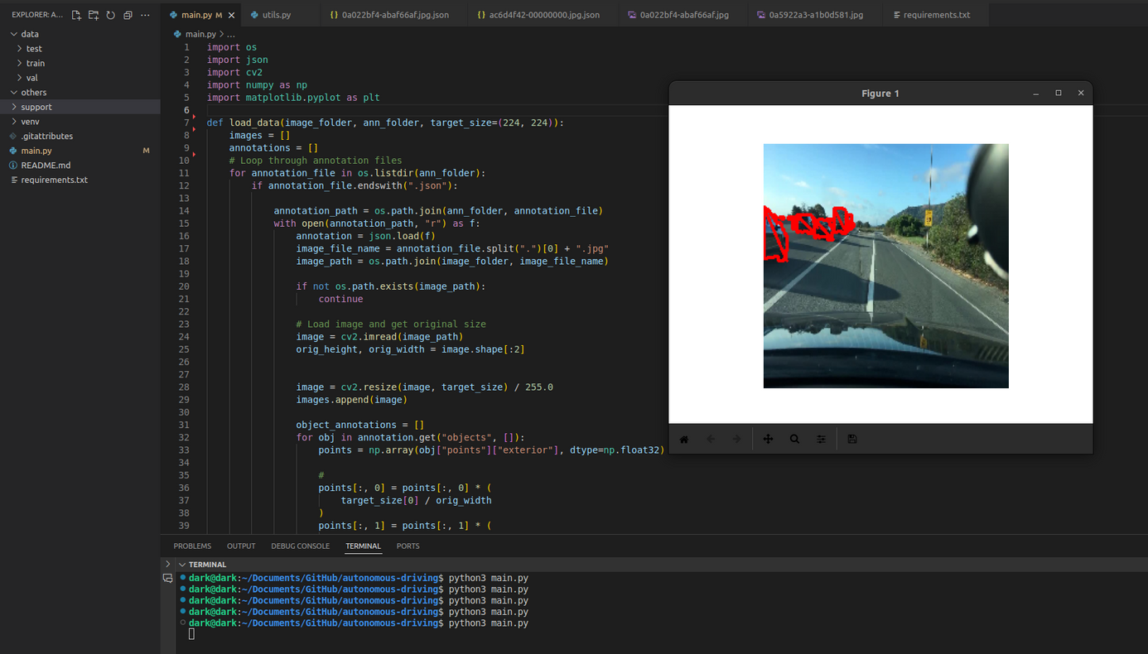
sample code for Annotation and access datasets :

Slide 7
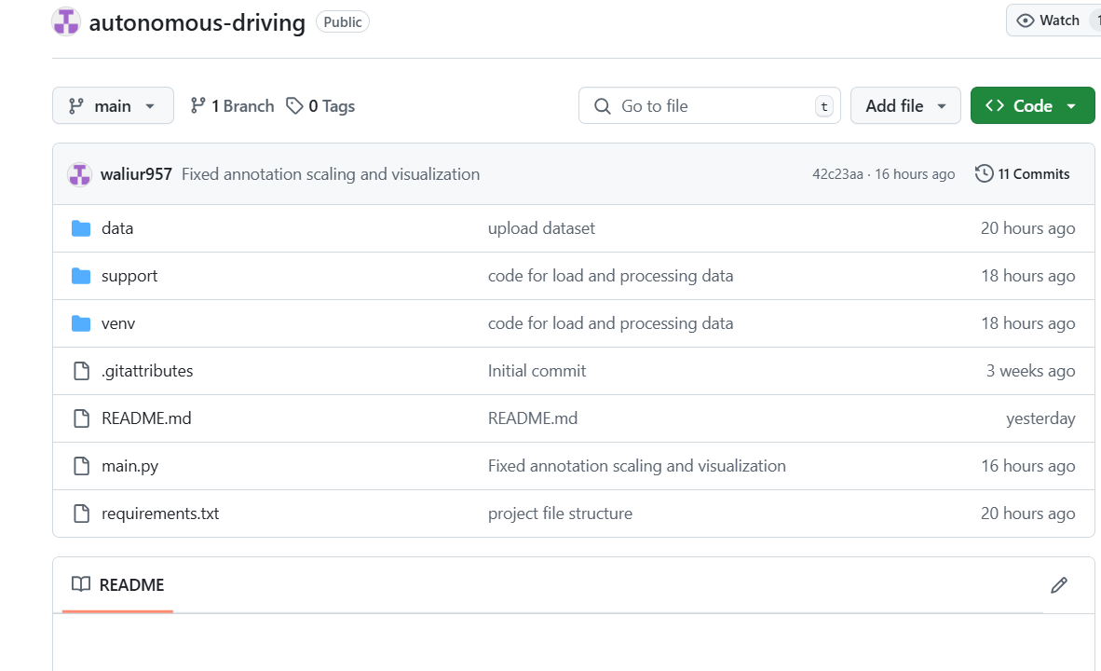
Github repostary link
https://github.com/waliur957/autonomous-driving
Addressing Overfitting

Slide 8
FUTURE STEPS :
02
03
01
Further Enhancements: Future work will involve
improving the model by experimenting with different
architectures and hyperparameters.
Model Training: The model will be trained using the
BDD100K dataset to detect lanes and objects in the
images.
Testing and Evaluation: After training, the model will
be tested on the validation set, and its performance will
be evaluated based on accuracy and speed.

Slide 9
CONCLUTION
and model setup. The BDD100K
Dataset has been successfully integrated into the project, and
image processing tasks have been handled using OpenCV
and Matplotlib. The next steps involve training the model
and testing its performance for accurate lane and object
detection.
The autonomous driving machine learning model is pro-
gressing well. The initial stages focused on data preprocessing-
ing, annotation handling,

